Slide 1
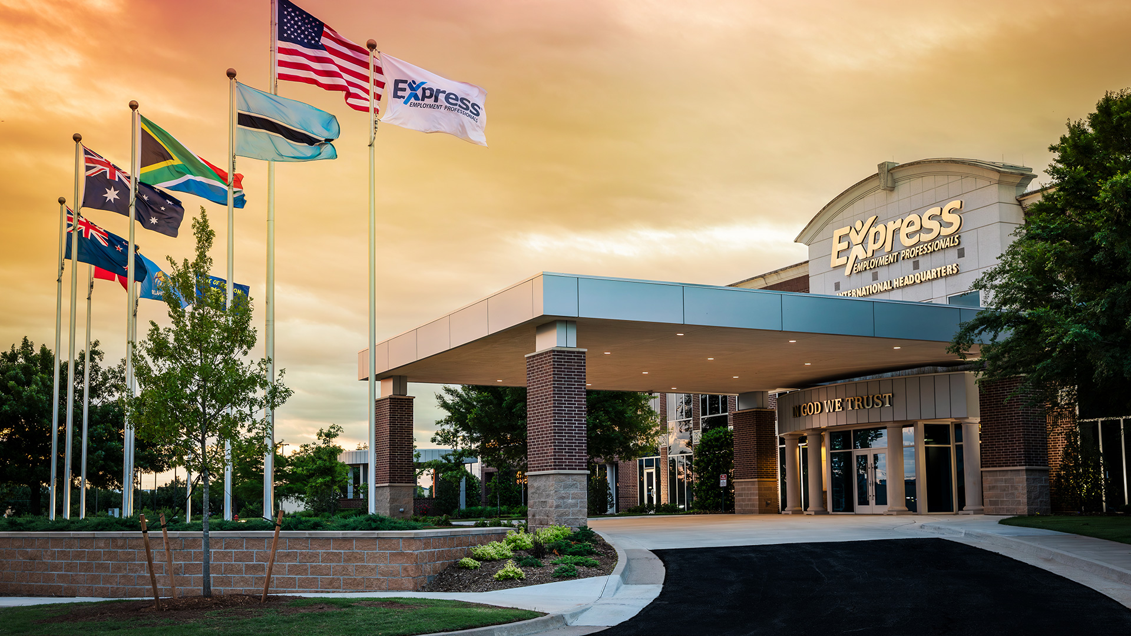

Notes:
32

Slide 2


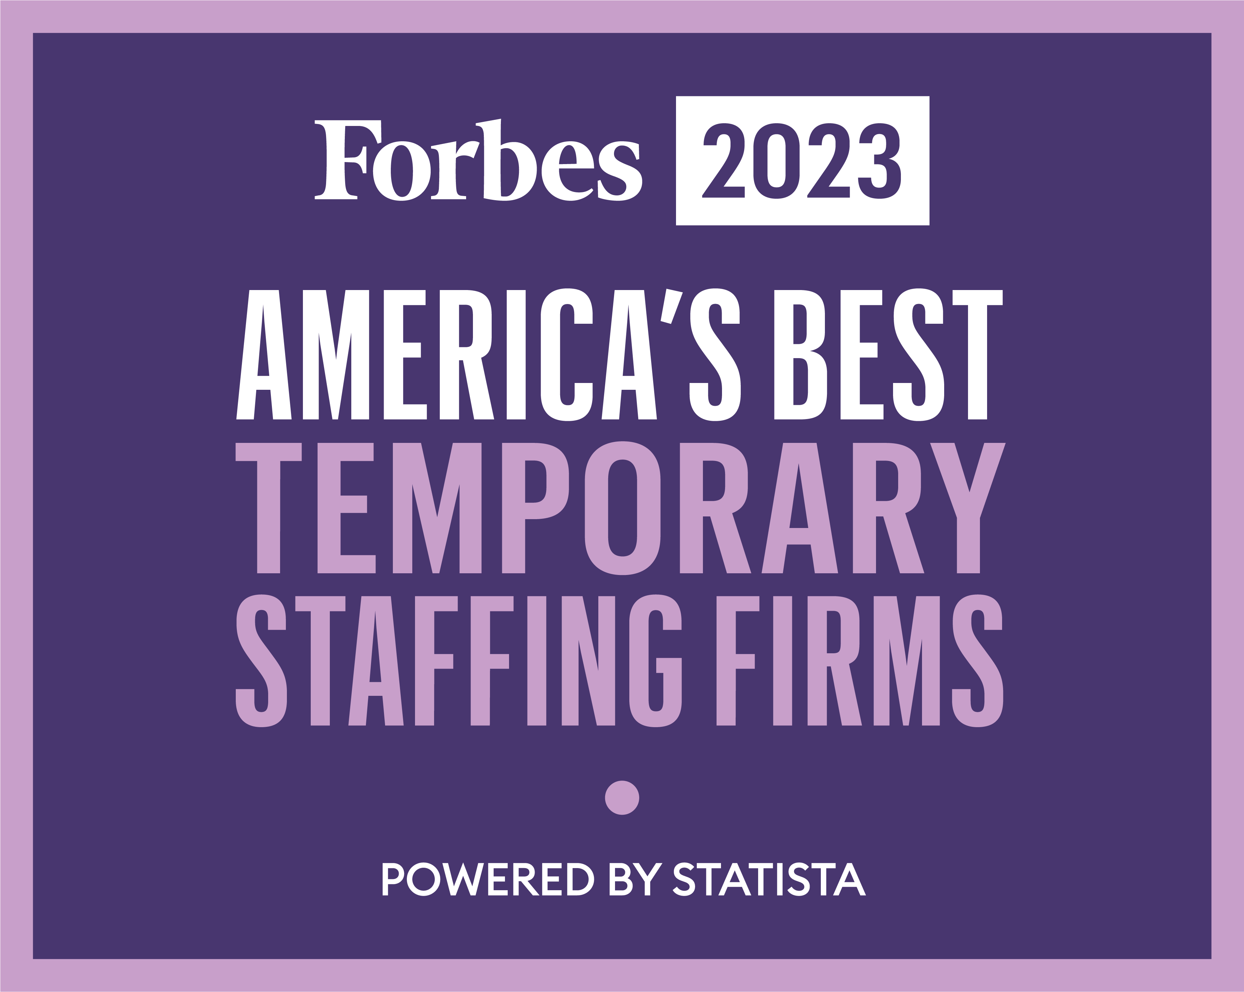
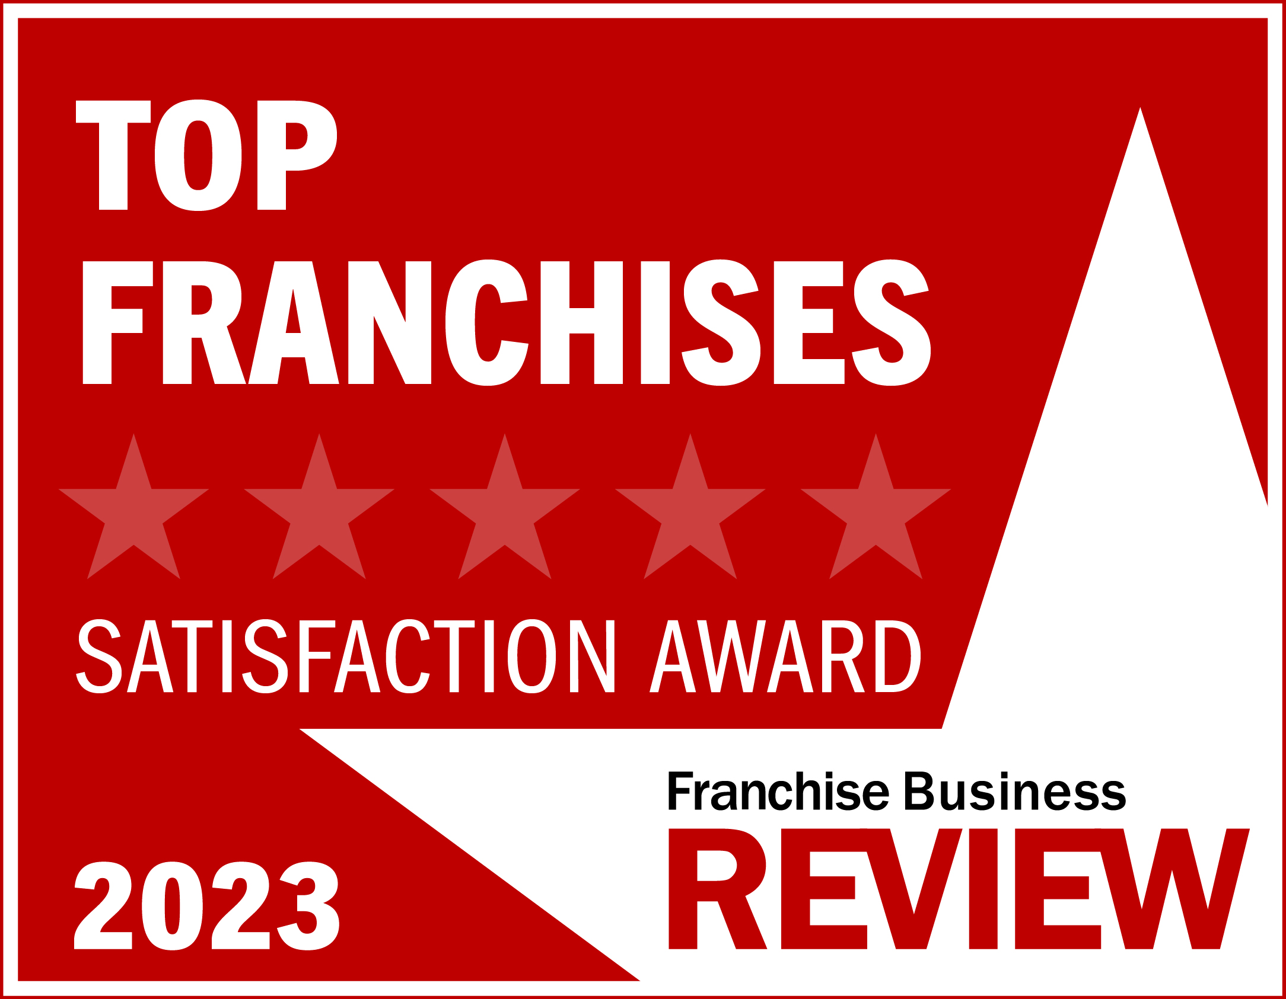
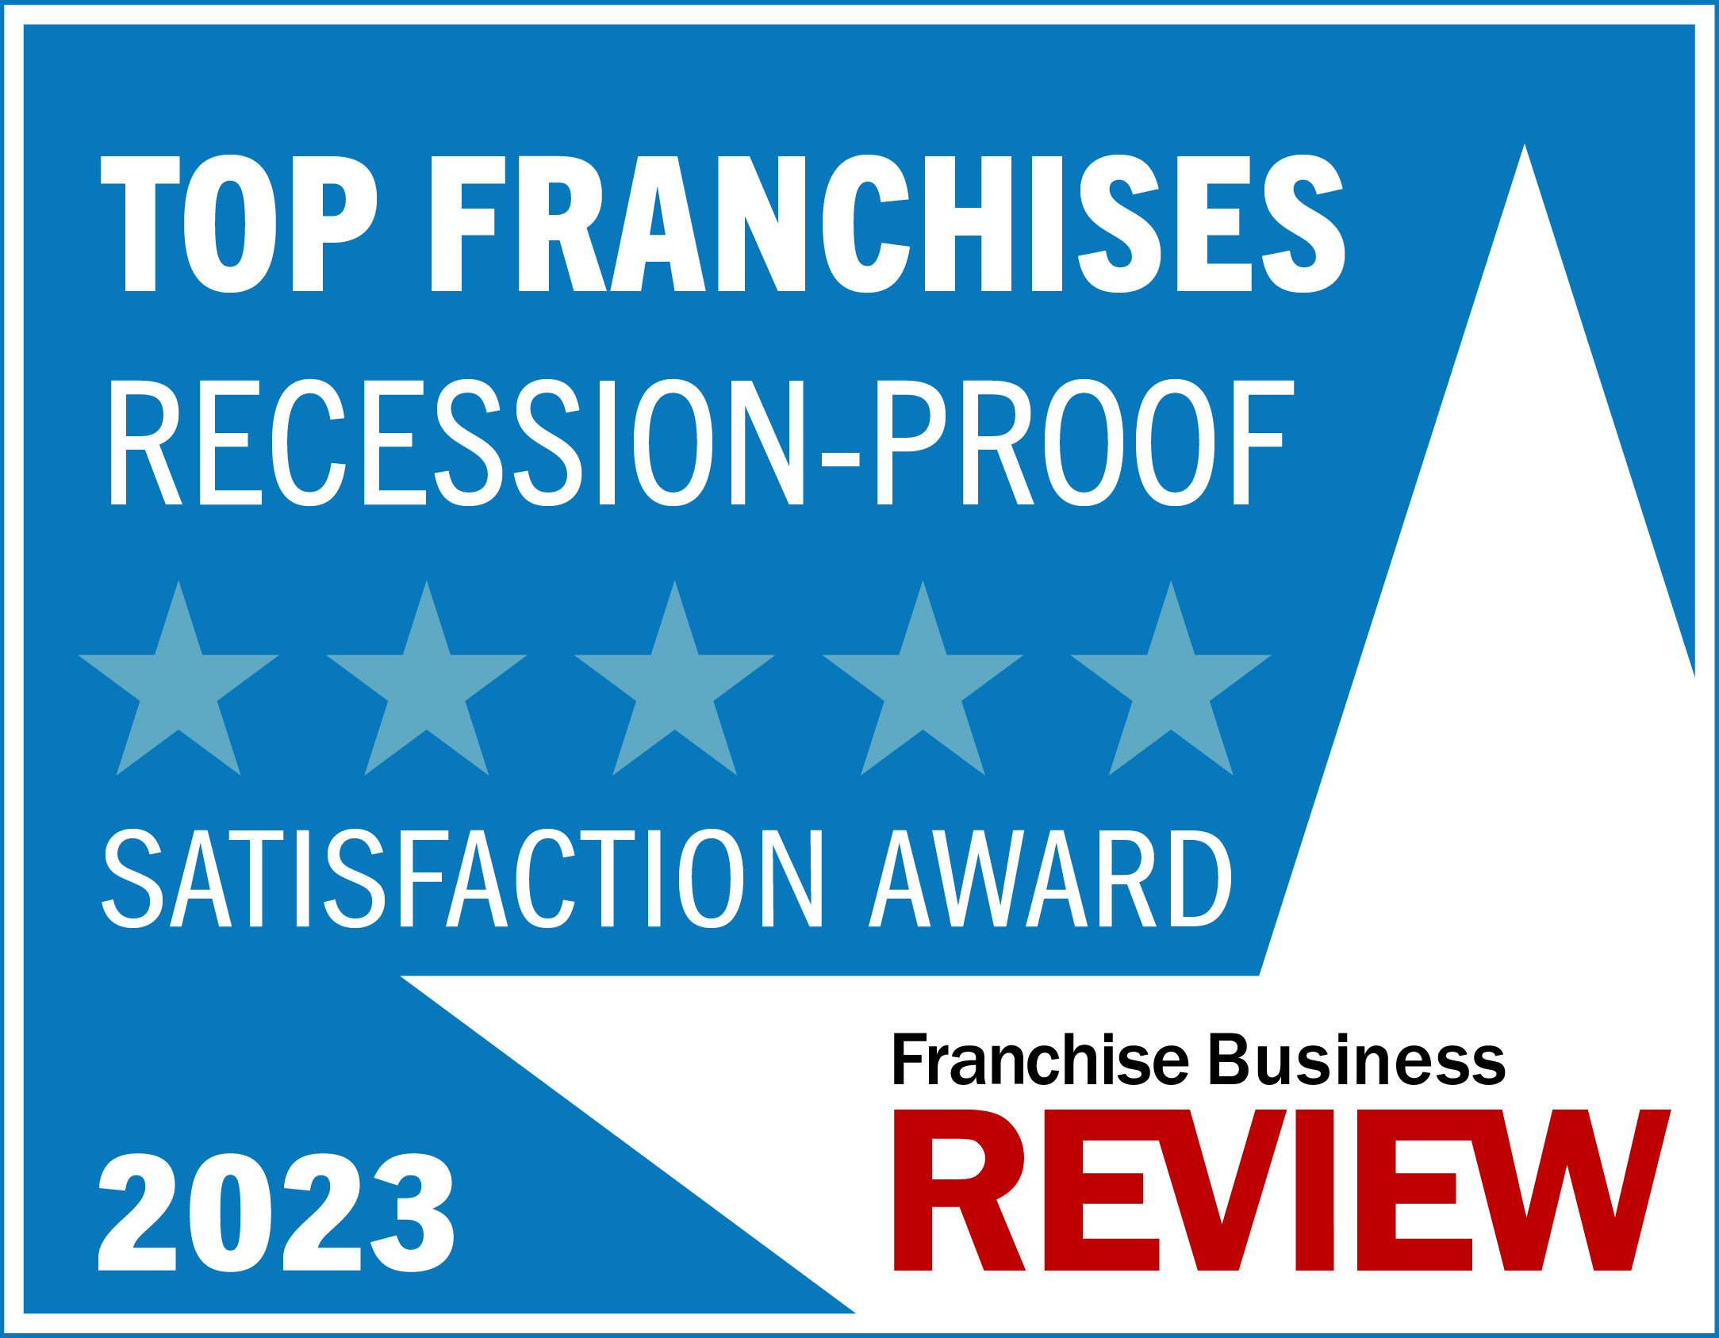
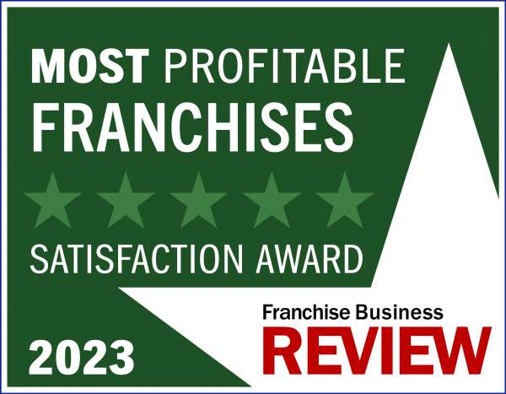

Express History and Highlights
Founded in 1983
$1 Billion in annual sales by 1999
$4 Billion+ in annual sales last three years
860+ offices in U.S., Canada, South Africa, Australia, and New Zealand

Slide 3

What It Takes
Total Investment
    $132,000 – $213,000
    Includes $40,000 Franchise Fee
Day in the Life
    Sell, Sell, Sell
    Transactional Selling
    Aggressive B2B Sales Model
    Managing and Leading Internal Team
    Fast Paced with New Challenges Everyday
Notes:
Transactional Selling
Not Consultative Selling in the initial stages

Slide 4

Ideal Candidate
Full-time active owner operator
Sales-minded
Relationship builder
Knowledge and experience with business operations
Communication and leadership skills
Staffing experience is not required
Notes:
Ninety-five percent of franchisees come to us with no prior staffing experience. Ideal candidates for Express are high-energy, community-minded sales leaders with experience leading teams.

Slide 5


Unparalleled Support
Funding of associate payroll
Back-office support
Workers' compensation
Risk management
Legal
Collections/Receivables
Sales and Marketing resources
Franchise Systems Support Center

Slide 6





Training
New Franchisee training program
Fast Track +
Success Track
Lifelong learning through Express University
Local in-field support
Notes:
New Franchisees will receive four weeks of initial training.
Franchisees have ongoing learning opportunities through Express University, including online courses, development tracks, and training calls.
Regional Developers serve as business coaches for owners to assist with practical action items.

Slide 7
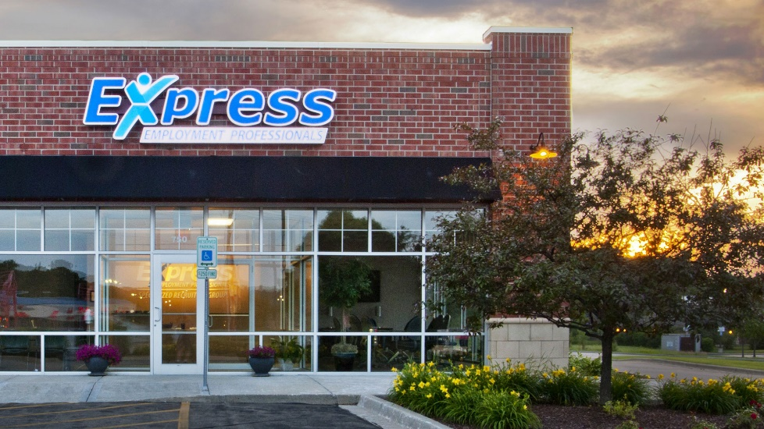
Why Express?
Recession Resilient
    Companies consistently need workers, and people need jobs. As certain industries grow, we grow with them.
Low Investment, Low Overhead, and No Inventory
    Express has a low cost of entry, starting at just $132,000.
    Office spaces are typically a modest 1,000 square feet, starting with only two employees.
Item 19 Demonstrates an Exceptionally Strong ROI
    In 2023, offices open more than 24 months saw an average of $5.9 million in annual sales.

Slide 8
Why Express?
Excellent Validation
    We hold a 98% satisfaction rating with our franchise location owners primarily because of our support system, which includes training, field support, a toll-free assistance center, and an international headquarters with a support staff of more than 400 professionals offering expert guidance.
Longevity
    Express celebrated 40 years of operations in 2023. We are a global staffing leader and trusted brand. The average tenure for franchisees is more than 12 years with owners building generational wealth.

Slide 9
Opportunities
New Territories
    Low-cost franchise opportunity starting at $132,000
    Exclusive territory… positively impact your local economy
Resale Opportunities
    Get a head start in business ownership
    Structured resale process
    Underperforming units can be a great investment
      Be willing to follow our proven system

Slide 10

New Office Incentive
New Franchisee Incentive Program
    Receive $20,000-$40,000 of the franchise fee back by hitting sales milestones within the first six months of business. Contact our Franchising Team for more information on the Fast Track Incentive!

Slide 11

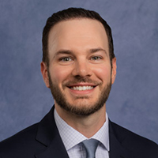
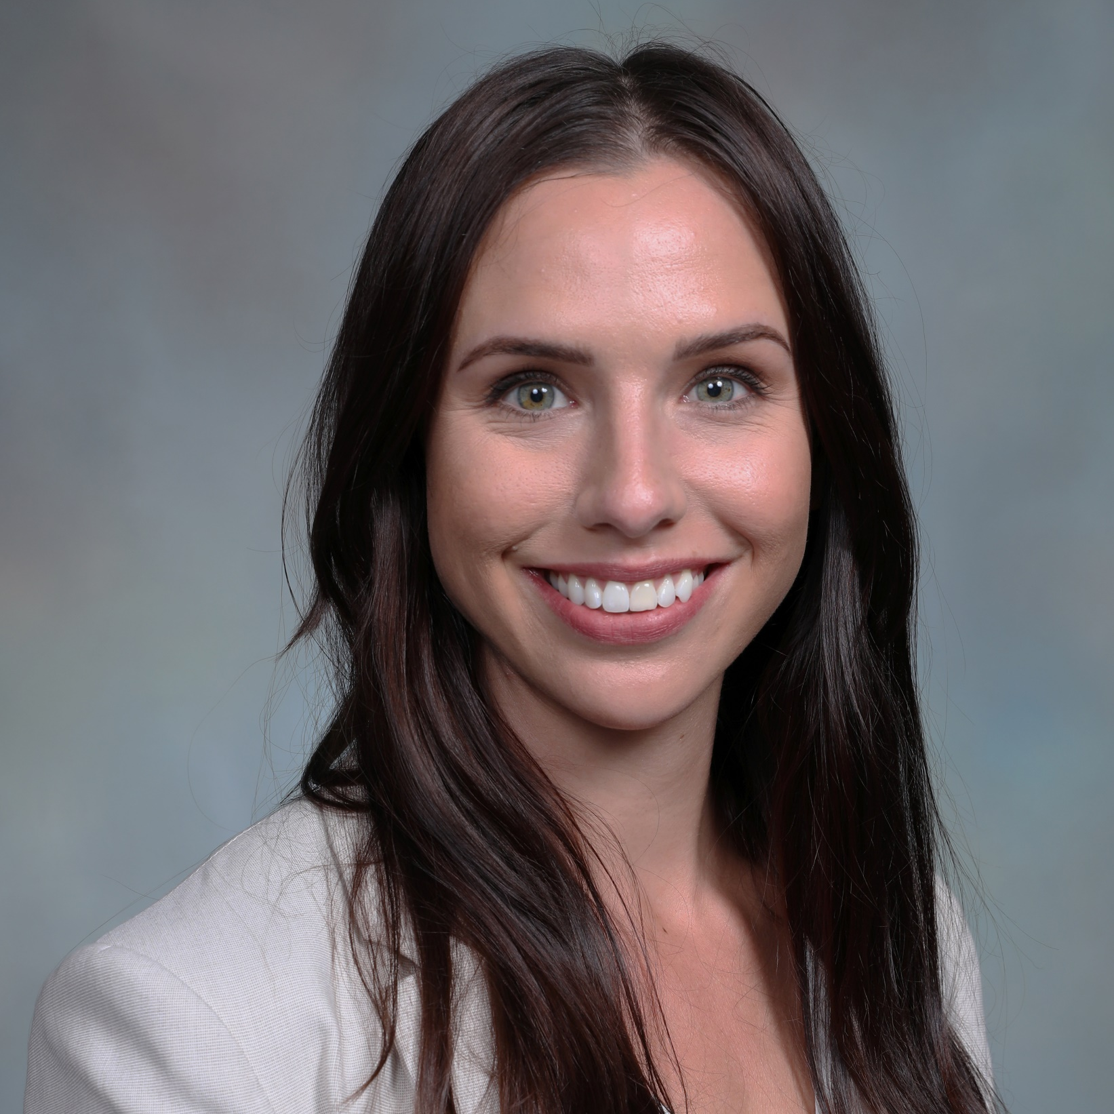
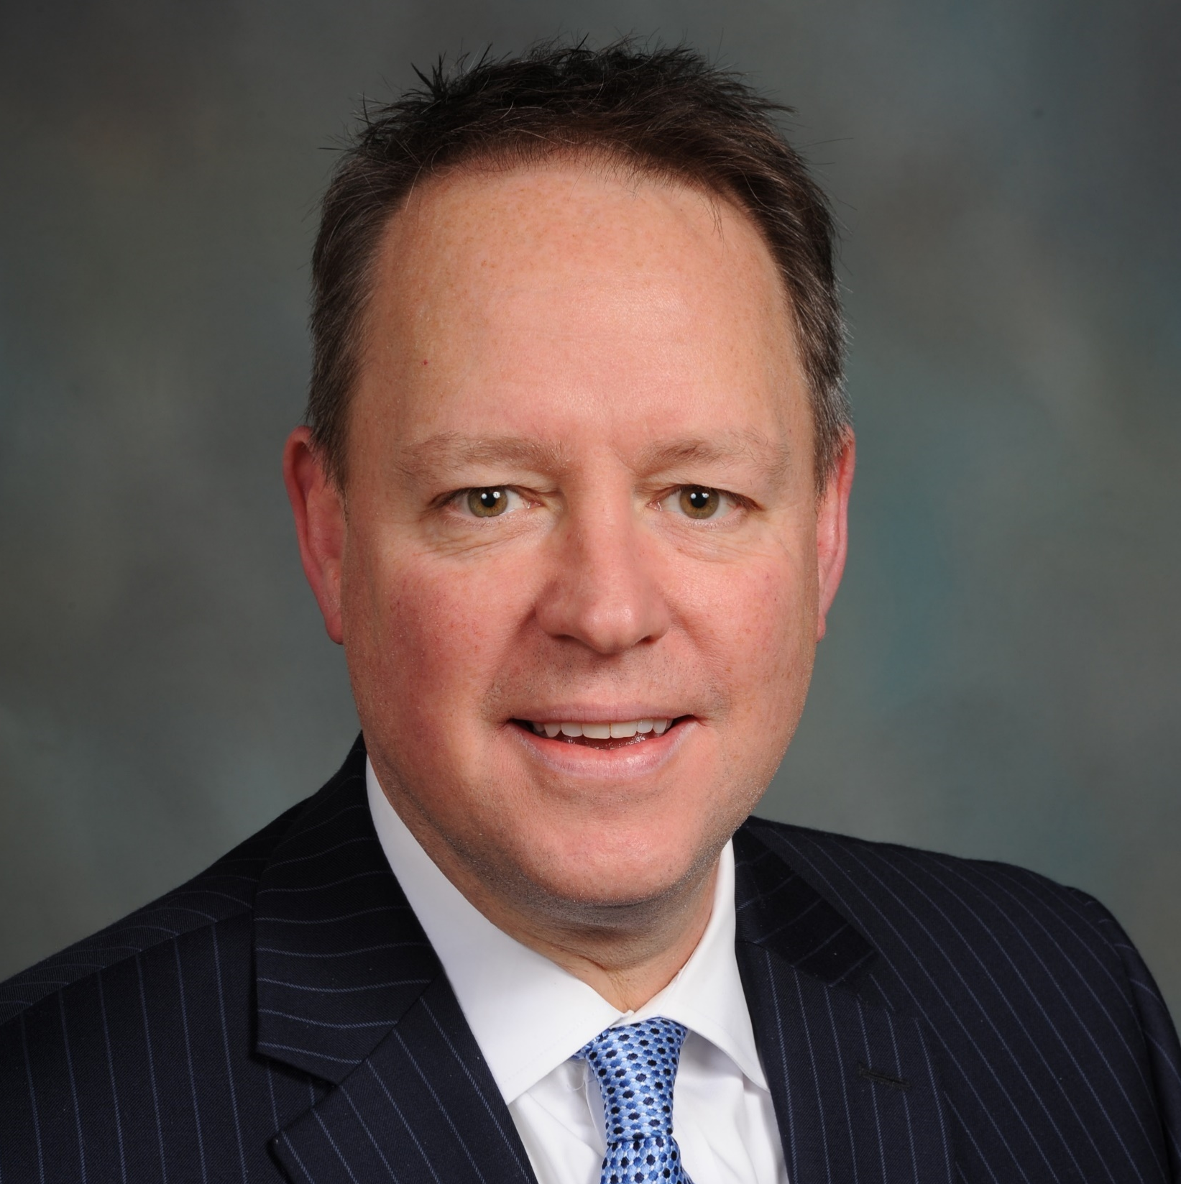
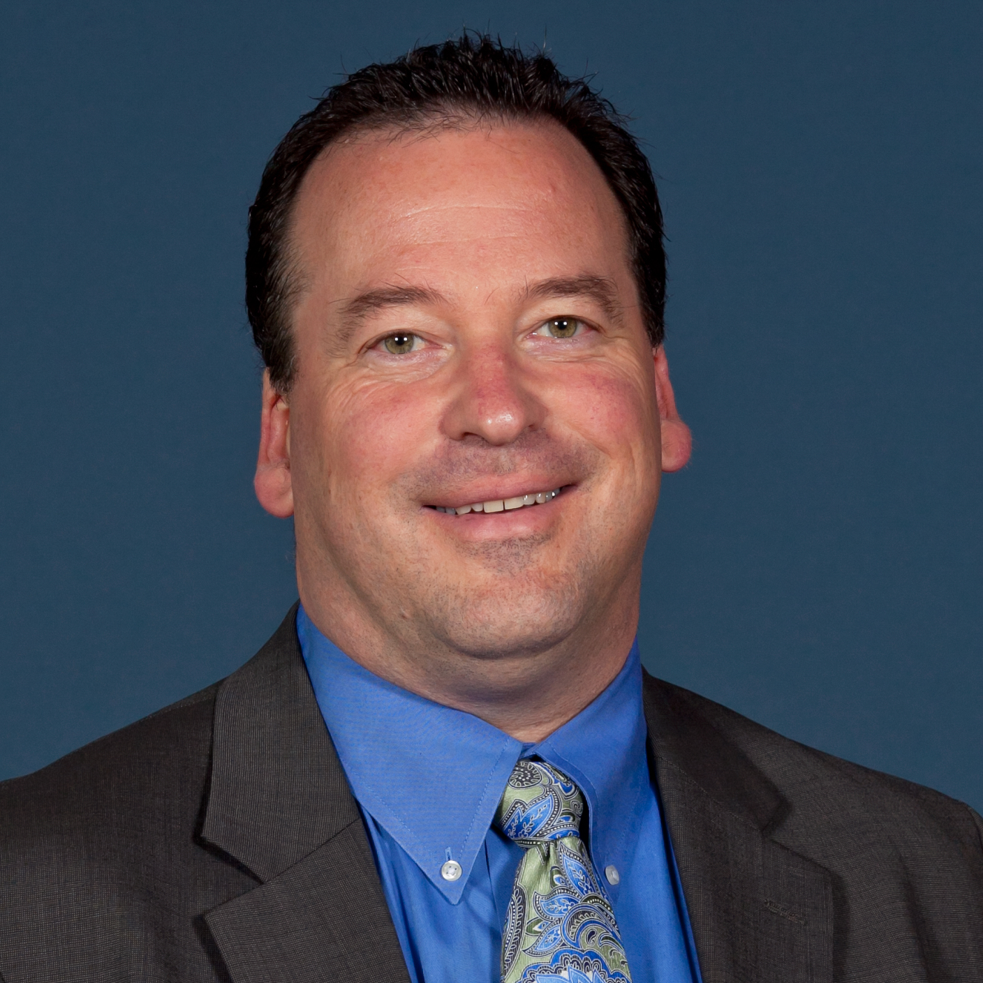
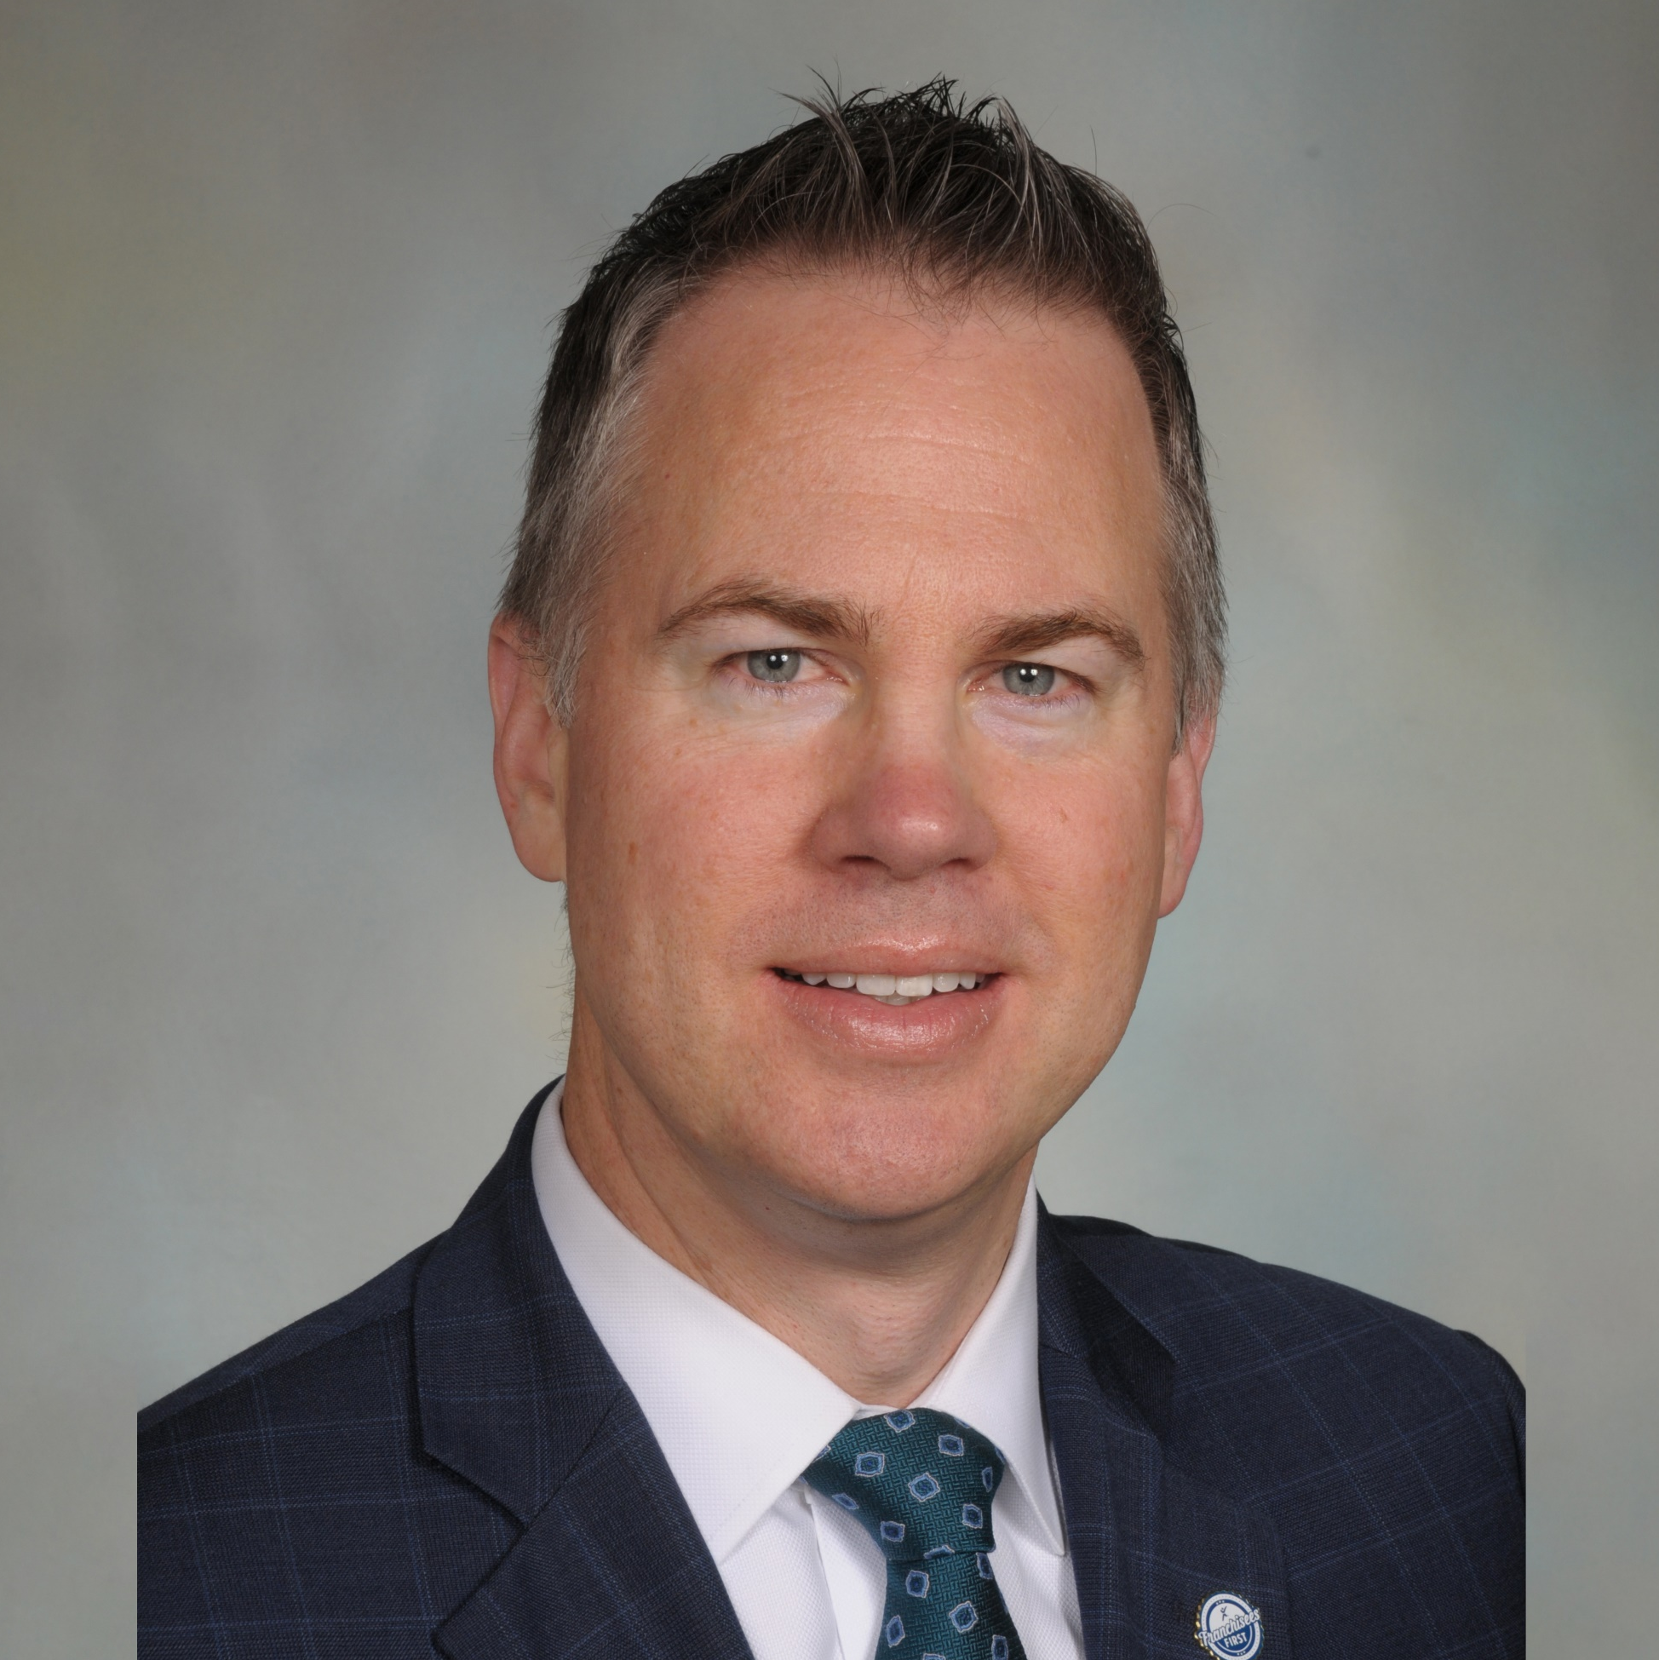
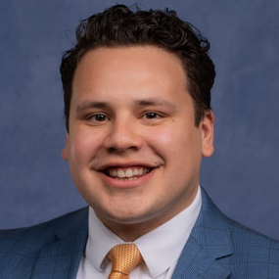
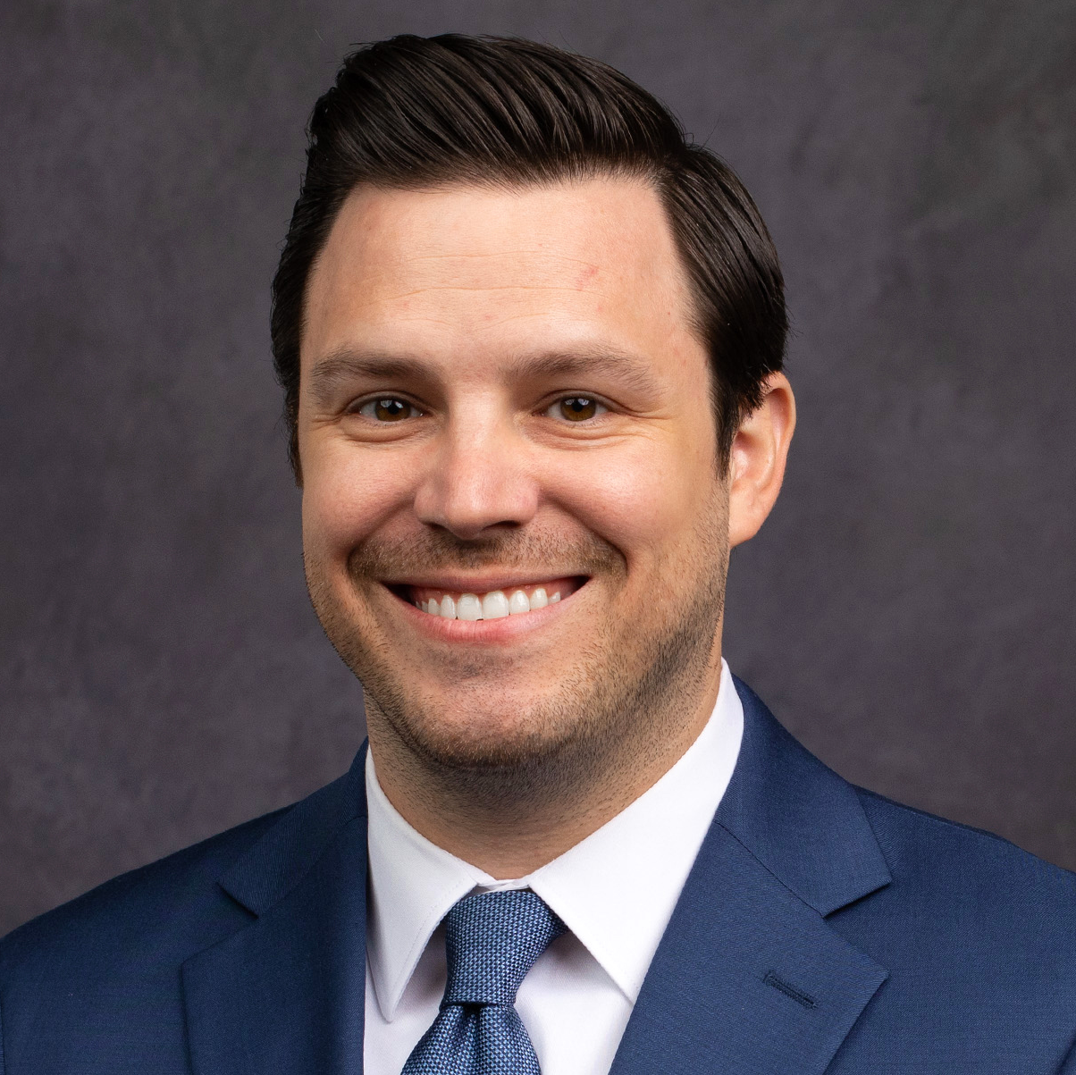
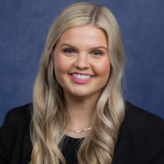
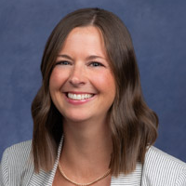



Express Franchising Team
franchising@expresspros.com
877-652-6400
Notes:
32

